Slide 1

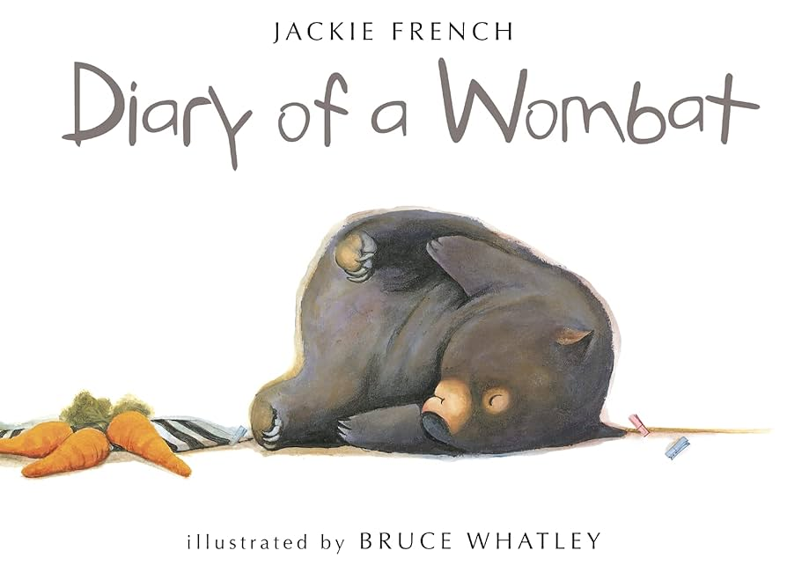
Term 1; Learning in Year 1 and 2 - History Makers
History
Who is the greatest history maker?
Learning how people in the past are referred as ‘history makers’.
Understanding Guy Fawkes and bonfire night.
Malala Yousafzai
Margaret Thatcher
Hatshepsut
Marie Curie
Grace O’Malley
Elizabeth 1st
Literacy
The Suitcase
Stories about feelings.
Identify sentence types and learn about conjunctions
Create a character and write a story
The Diary of a wombat
To spell and capitalise the days of the week.
Use of first-person.
Past tense and correct verbs.
Letters, postcards and diary entries.
SPAG year 2;
Nouns; Head noun phrases; Vowels and Consonants; Demarcating Sentences; Nouns using ‘-ness’; Punctuating sentences.
Science
Animals including humans part 1
Year 1
Be able to name and locate parts of the human body, including those relating to the senses.
Be able to identify and name different common animals including fish amphibians, reptiles, birds and mammals.
Be able to describe and compare the observable features of animals from a range of groups.
Year 2
Know about the basic needs of animals, including humans, for survival.
Describe the importance of exercise, balanced diet and hygiene for humans.
Describe the main changes as young animals, including humans, grow into adults.
Art
Drawing: Making your mark
Exploring line
Making waves
Experimenting with media
Mark making
Drawing from observation
Using these techniques whilst exploring different Art focussed on each History maker.
Maths
Number: Place value:
Count objects within 10.
Understanding numbers 11-20.
Greater than, less than.
Understanding number lines.
Addition and subtraction:
Number Bonds to 10 and to 20.
Doubles and near doubles.
Part whole models, fact families.
RE; year 1
Who is a Christian and what do they believe?
RE; year 2
Who is Jewish and what do they believe?
Computing; year 1
Community systems and networks – technology around us
Computing; year 2
Computing systems and networks – IT around us
PE
Invasion games
Yoga
Music
Hey you! And old school hip-hop songs.
Focus on pulse, rhythm, pitch and how they work together.
Spanish
About me.
Enrichment:
Visit from Kent fire service
Music

