Slide 1
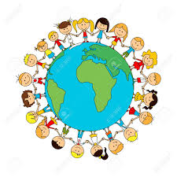
Our world
Literacy – Labels, lists, captions, and recounts. Non Fiction: The Big Book of the Blue Fiction: That rabbit belongs to Emily Brown At the beach Dougal’s deep sea diary Sally and the Limpet Dear Greenpeace Poetry: A first book of the sea.
Plan sentences aloud before writing.
Finger spaces.
Full stops and capital letters.
Labels, lists and signs.
Re-tell a story.
Art and DT Tortoise sewing Pebble painting Jelly fish Shark pictures Sea collages Salt dough star fish
RE Caring for others Look at stories from other religions and faiths. Look at how to care for and look after others.
Numeracy Weeks 1-4: Place value Count to 10 forwards and backwards from any given number. Count, read and write numerals to 10. Identify one more and one less. Identify and represent numbers using objects and pictorial representations including the number line, equal to, more than, less than, most, least. Weeks 5 -7: Addition and subtraction. Represent and use number bond facts including subtraction. Read, write and interpret mathematical statements involving addition, subtraction and equals signs. Add and subtract one digit numbers including zero. Solve one step problems that involve addition and subtraction using concrete objects and pictorial representations and missing number problems.
Topic What makes the world go round? Explore the different seas. Where are they? What are they called? Are they hot or cold? Who lives where? Animal habitats. Great Barrier Reef, migration, does anything live in the Arctic? Climate change What is happening to our oceans? Plastic polution
ICT Computer skills How to: use a track pad/mouse turn on and off open new windows save files
PSHCE
Politeness and courtesy.
Friendships
Science
Week one: Ourselves. Week two: Look at our bodies Week three: What can we hear? Week four-six: Senses
Music Rhythm and pulse
PE
Invasion games.
Ball skills.

